Slide 1
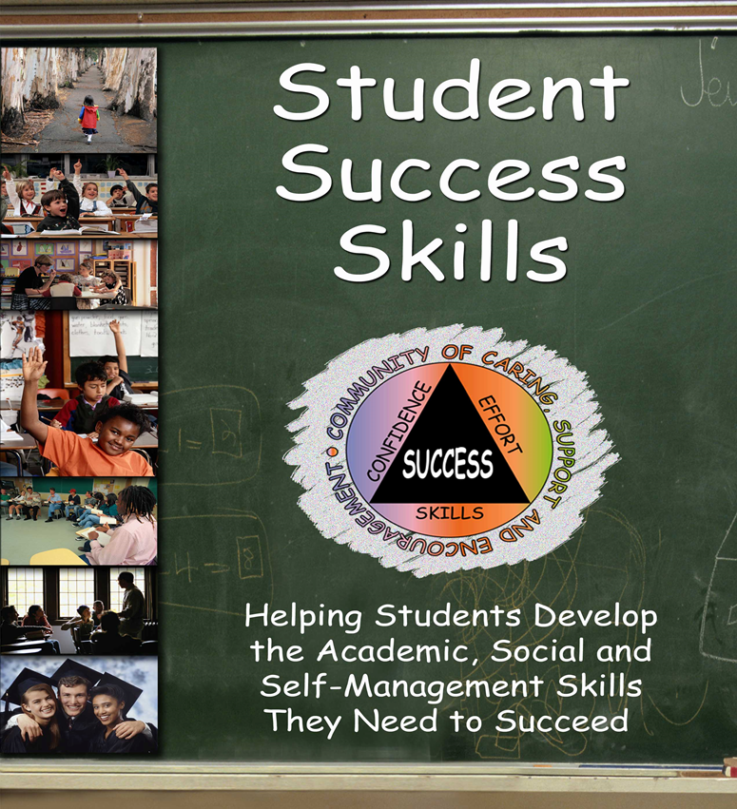


Program Overview
& Research Results
Dr. Greg Brigman
&
Dr. Linda Webb
Notes:
School counselors are part of the educational community focusing on academic achievement by helping students develop the academic, social, and self management skills they need to succeed. School counselors can support teachers in their instructional efforts to help students achieve academic outcomes in line with their potential. In addition, these same skill sets help students to have better social relationships, maintain better mental and emotional health and create more caring and positive classroom environments.

Slide 2

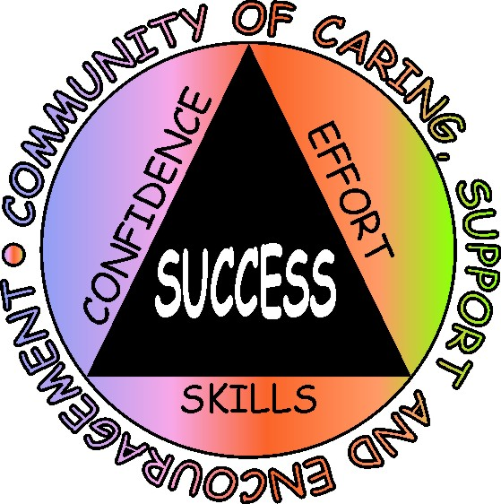
Student Success Skills
Overview of key components
Research base supporting development of the program
Research results reflecting outcomes of using the program
Key components and tools embedded in the program
Program implementation
Notes:
This brief presentation will provide an overview of an evidenced based program that has been successful in improving the academic and social competence of students. Relevant research supporting the program will be shared followed by a look at the tools embedded in the SSS program that help students achieve success. Finally, some ideas about program implementation will be presented.

Slide 3
Notes:
The Student Success Skills (SSS) Program focuses on developing key skills and attitudes in an environment of caring, support, and encouragement that increases student confidence and effort contributing to student success.

Slide 4


Three Keys to Building Resilience and Reducing School Failure
Skills: Cognitive, Social and Self-management
Attitudes:
Healthy Optimism, Solution Focused
Climate: Caring, Support, Encouragement
Notes:
The combination of certain skills, attitudes and classroom climate is the heart of the Student Success Skills program and can significantly improve your students academic and social performance this year.

Slide 5
Three Key Skill Sets for
Student Success
Learning
Skills
Social Skills
Self-Management Skills
Notes:
The SSS program focuses on three key skill sets which are fundamental to learning and wellbeing.

Slide 6
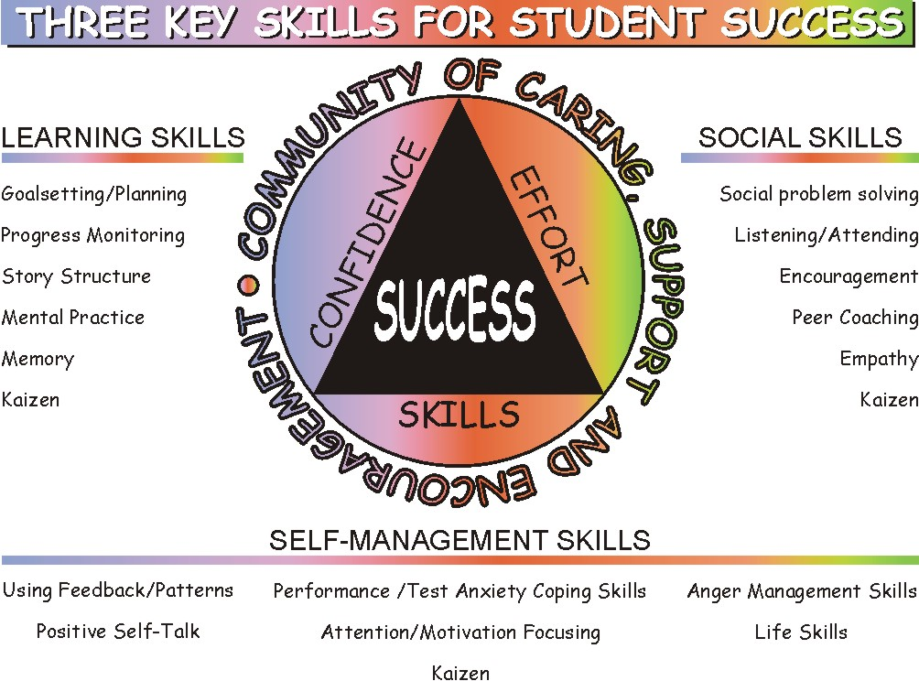
Notes:
Multiple large reviews of research on educational interventions have found a similar set of skills contributing to academic success and are the foundation for the Student Success Skills Program. These include: Cognitive/learning skills such as goal setting, progress monitoring, and memory skills; Social skills such as interpersonal skills, social problem solving, listening, and team-work skills; Self management skills such as managing attention, motivation, and anger. All three skill sets work in concert and each requires systematic teaching.

Slide 7
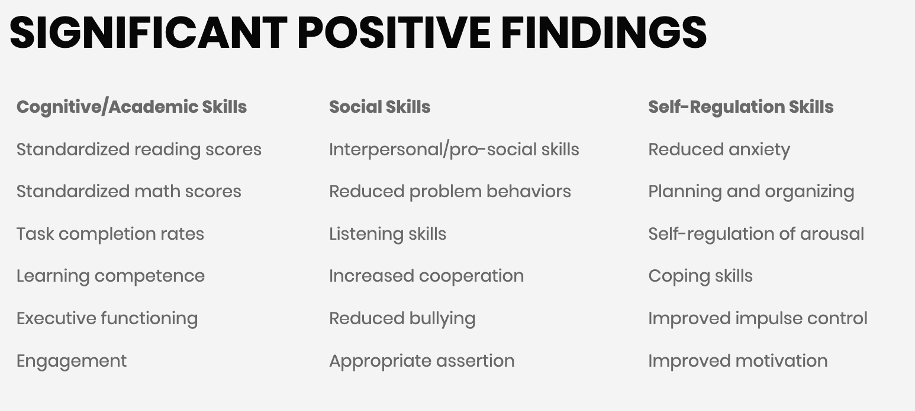
Student Success Skills Published Research Findings
Notes:
Greg
Over 25 published SSS studies have measured various outcomes under the heading of academic, social and self-management skills.
Take a look at each category and see if you can find at least 1-2 that would be important to you and your leadership team.

Slide 8
SSS Efficacy Research
Over 25 published articles on SSS in leading professional journals.
Three national award winning research articles
Notes:
Key findings of four recent research studies involving school counselor led groups and classroom guidance focused on the Student Success Skills (SSS) approach.

Slide 9

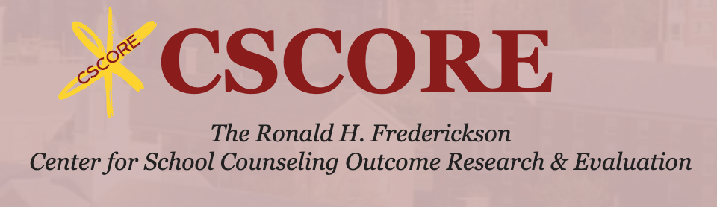


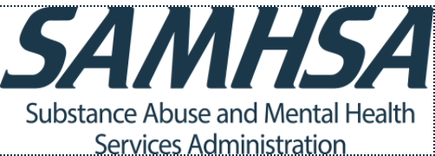

One or more of the the Student Success Skills Programs are featured in all six of these evidence-based guides
Collaborative for Academic, Social,
and Emotional Learning (CASEL) Program Guides
What Works Clearinghouse
Fredrickson Center for School Counseling Outcome Research and Evaluation (CSCORE)
SAMHSA Evidence-Based Practices Resource Center
RAND Center for Social and Emotional Learning Research
The Best Evidence Encyclopedia
Center for Data-Driven Reform in Education
Johns Hopkins University
Notes:
The CASEL Guide provides a systematic framework for evaluating the quality of social and emotional programs and applies this framework to identify and rate well-designed, evidence-based SEL programs with potential for broad dissemination to schools across the United States. The Guide also shares best-practice guidelines for district and school teams on how to select and implement SEL programs. Finally, it offers recommendations for future priorities to advance SEL research and practice.
The What Works Clearinghouse (WWC) has valuable tools for locating studies that meet the ESSA evidence requirements. Every Student Succeeds Act (ESSA) are designed to ensure that states, districts, and schools can identify programs, practices, products, and policies that work across various populations.
The Substance Abuse and Mental Health Service Administration Evidence-Based Practices Resource Center provides communities, clinicians, policy-makers and others with the information and tools to incorporate evidence-based practices into their communities or clinical settings.
The Johns Hopkins University School of Education's Center for Data-Driven Reform in Education (CDDRE) was established in 2004 as a research center on low-achieving schools. As its name implies, CDDRE carries out research, development, and dissemination of state, district, school, and classroom strategies that use data on student performance to direct reform efforts.
CSCORE is committed to providing a powerful vision for school counseling in 21st-century schools. This includes providing evidence-based resources that support k-12 students in their academic, social/emotional, college and career aspirations and achievements.
The RAND Center for Social and Emotional Learning (SEL) Research provides new evidence about the effectiveness of SEL programs and practices. We also translate that evidence into concrete guidance to inform policy and practice at all levels of the education system.

Slide 10
SSS Research
Over 10,000 counselors and teachers have used SSS with
  Over 4 million students
  In grades K-12
Notes:
Key findings of from recent research studies involving school counselor led groups and classroom guidance focused on the Student Success Skills (SSS) approach.
The findings were consistently very positive, showing student improvement in math reading and behavior and other measures.

Slide 11
Villares et al, (2023).
13 randomized studies of a school counselor classroom intervention: SSS
Effect sizes for:
Cognitive measures - .22 (medium)
(standardized achievement tests, academic credits earned, grade point average, and content knowledge exams)
Behavioral Measures- .21 (small)
(decision-making, executing functioning, attendance, and discipline)
Affective Measures – .55 (medium)
(self-management, relationship skills, social awareness, self-awareness, and responsible decision-making, self-esteem, depression, test anxiety, anxiety, and locus of control)
Notes:
The 13 randomized studies included students elementary, middle and high school
Note what is included under each category: Cognitive, Behavioral and Affective

Slide 12
SSS U.S. Department of Education
IES Randomized Trial Grant (2011-2015)
2.7 million federal grant, 4 years, RCT Researchers:
  Florida State University
  Florida Atlantic University
  University of Massachusetts Amherst/ CSCORE
Partners and Volunteer Participants:
  Two school districts, 60 schools
  Elementary School Counselors
  5th grade teachers and students
Notes:
The SSS program is the only school counselor intervention ever funded by IES for this level of research grant. To qualify, the program must have a strong record of effectiveness
This study found positive results in several areas that are important to most educators.

Slide 13
Participants
Total Participants:
60 schools, 240 classrooms, 4500 students
Randomization at the school level
30 schools randomly assigned as treatment
30 schools randomly assigned as control
Notes:
After randomization, then we really checked for equivalency. 15 schools you can end up differences by chance.

Slide 14
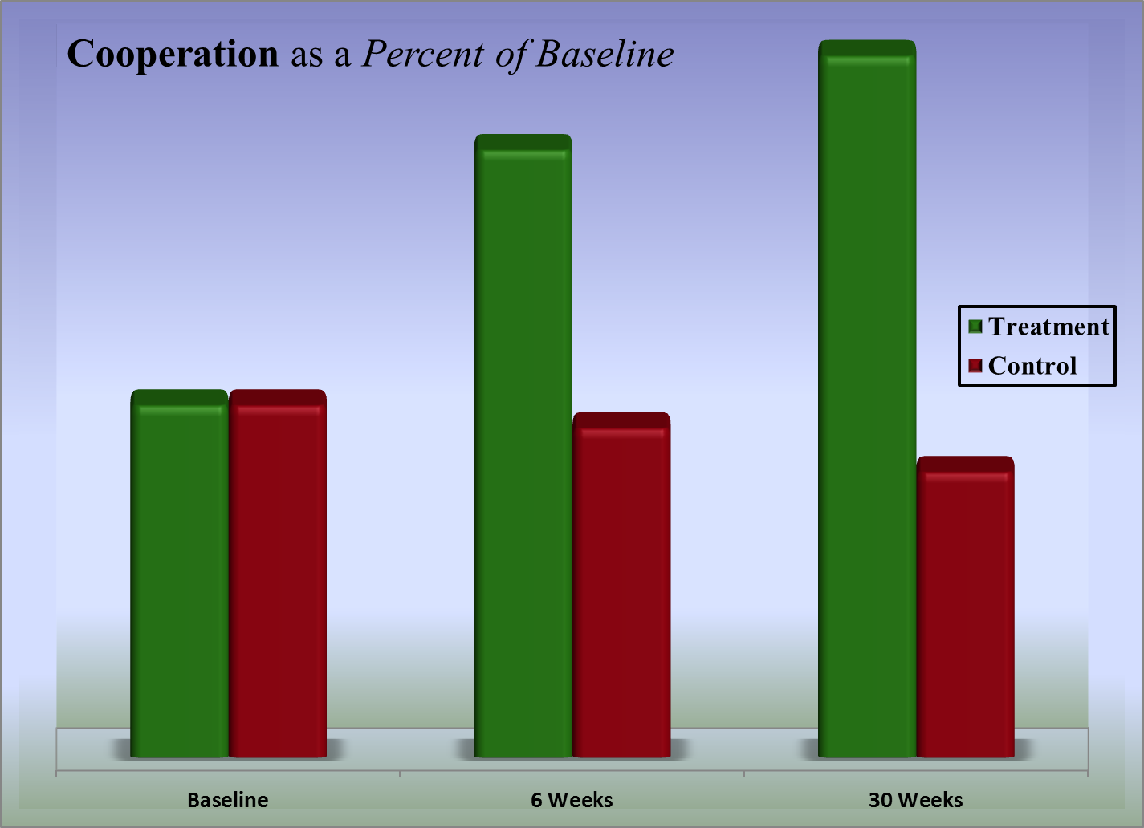
Notes:
Students More Cooperative in the Classroom. Students who participated in Student Success Skills (SSS) classroom guidance in the fall were significantly more cooperative during core instruction than those students who did not receive SSS. Notice that the positive impact continued and actually increased through to the end of the school year.

Slide 15
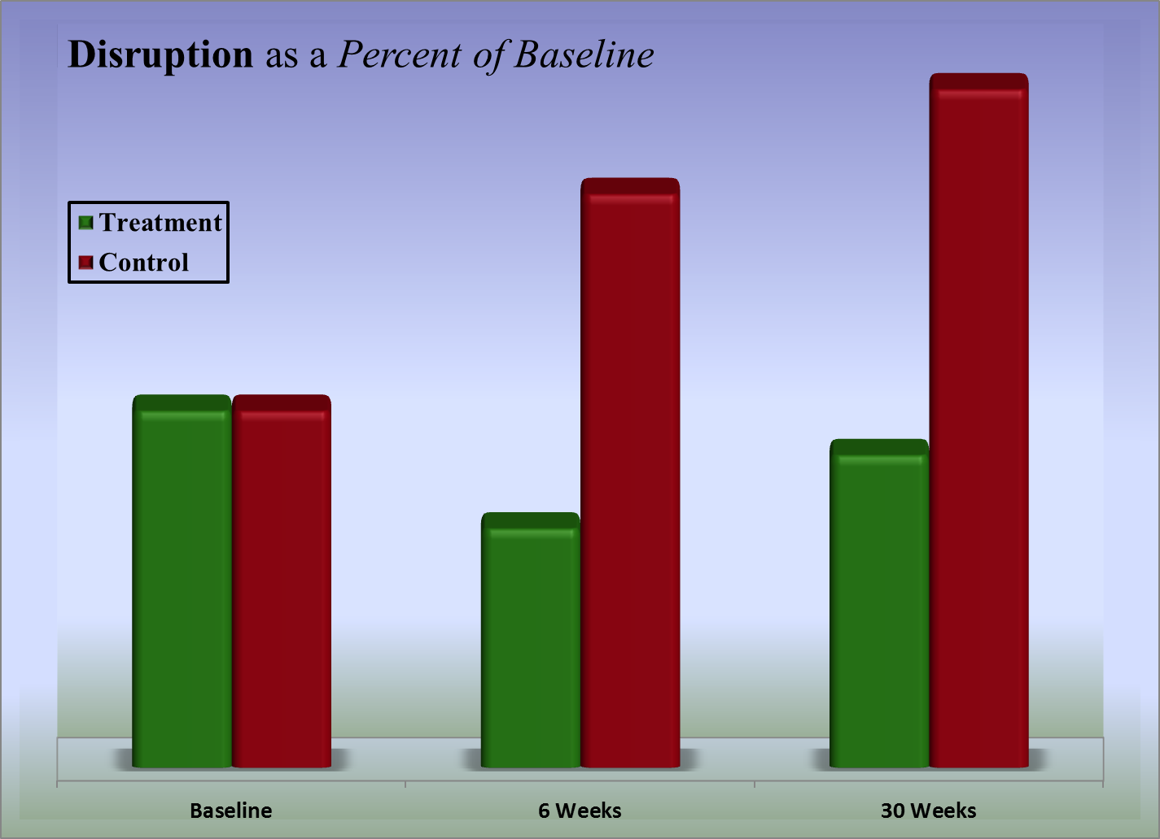
Notes:
Students Less Disruptive in the Classroom. Students who participated in Student Success Skills (SSS) classroom guidance in the fall were significantly less disruptive during core instruction than those students who did not receive SSS. Notice that they remained less disruptive then their peers throughout the school year.
There are two important things to notice on this slide:
SSS significantly decreases the amount of disruption (the green column is much short than the red column)
Even though disruption slightly increased at 30 weeks, it was much less the baseline and for the students who did not receive SSS instruction

Slide 16
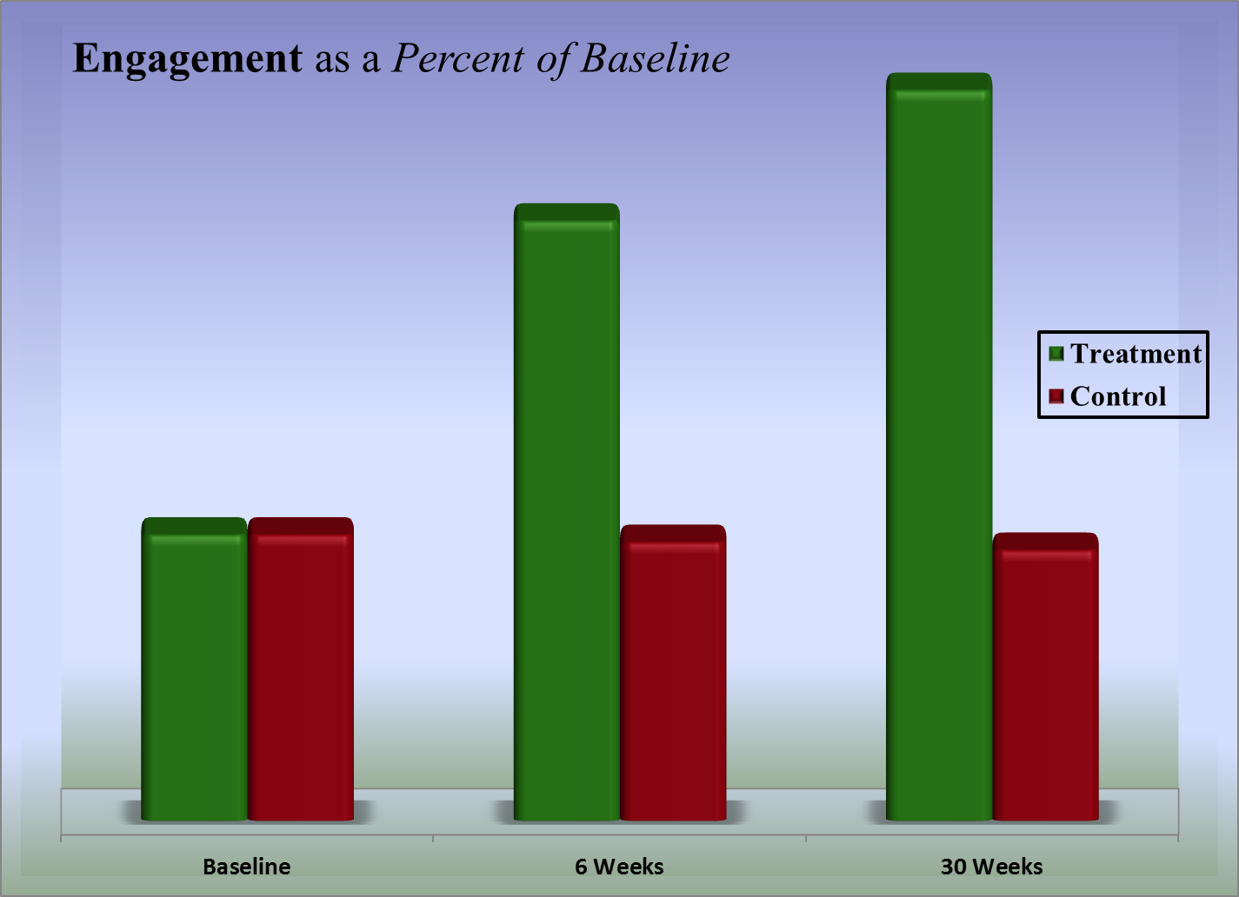
Notes:
Students More Engaged in the Classroom. Students who participated in Student Success Skills (SSS) classroom guidance in the fall were significantly more engaged during core instruction than those students who did not receive SSS. The level of engagement continued to grow throughout the school year.

Slide 17
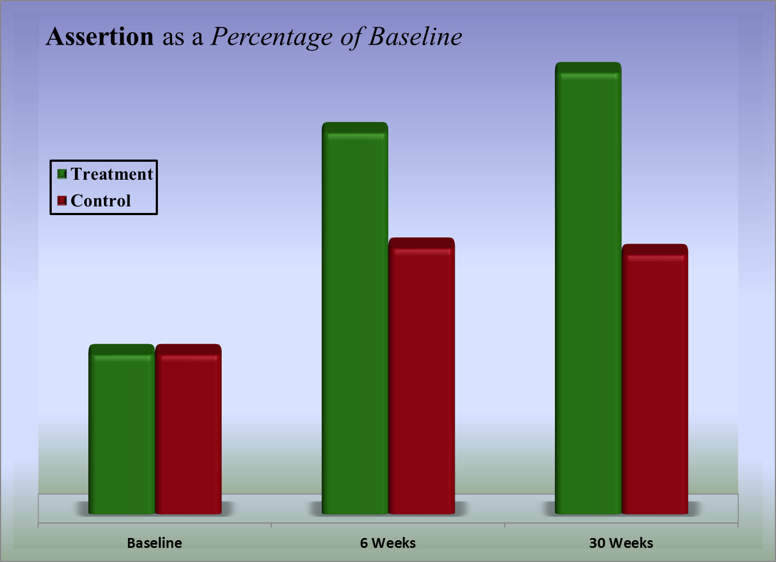
Notes:
Students More Assertive in the Classroom ( i.e. asking for help). Students who participated in Student Success Skills (SSS) classroom guidance in the fall were significantly more appropriately assertive during core instruction than those students who did not receive SSS. They continued to be more assertive throughout the remainder of the school year.

Slide 18
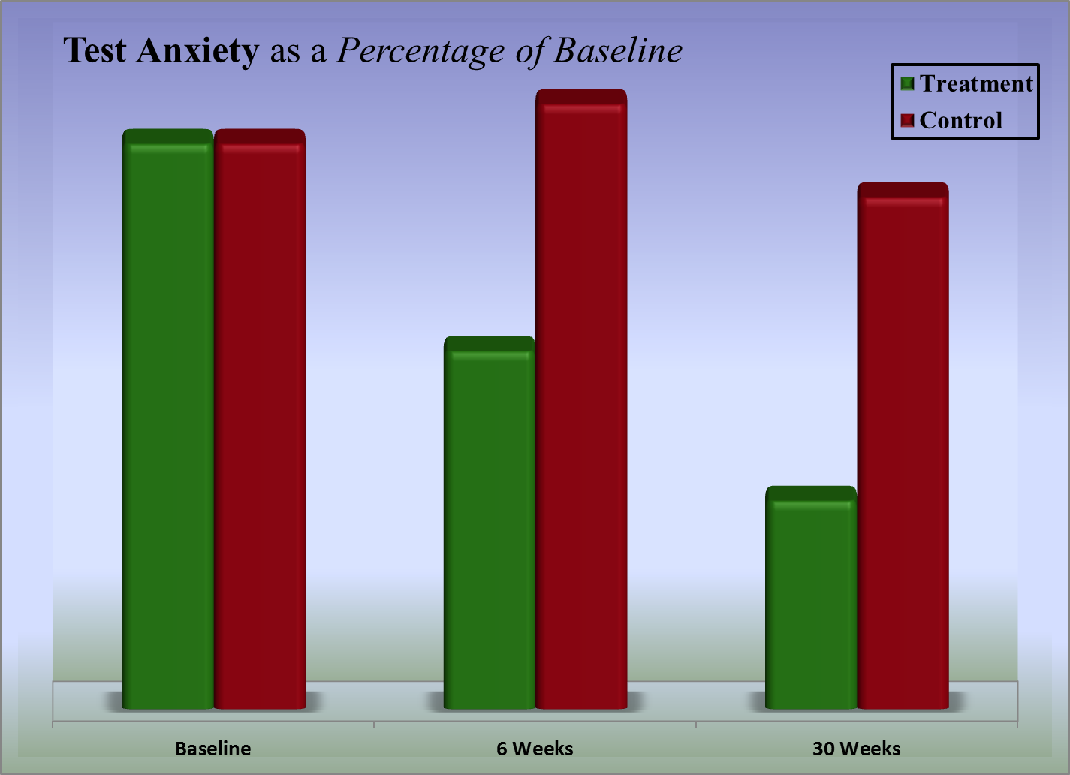
Notes:
Students Less Anxious in the Classroom. Students who participated in Student Success Skills (SSS) classroom guidance in the fall were much more able to deal with test anxiety and were less test anxious than those students who did not receive SSS. The level of anxiety around high stakes testing continued to decrease throughout the school year.
One important thing to notice on this slide:
SSS significantly decreases test anxiety in both the short term and the long term

Slide 19
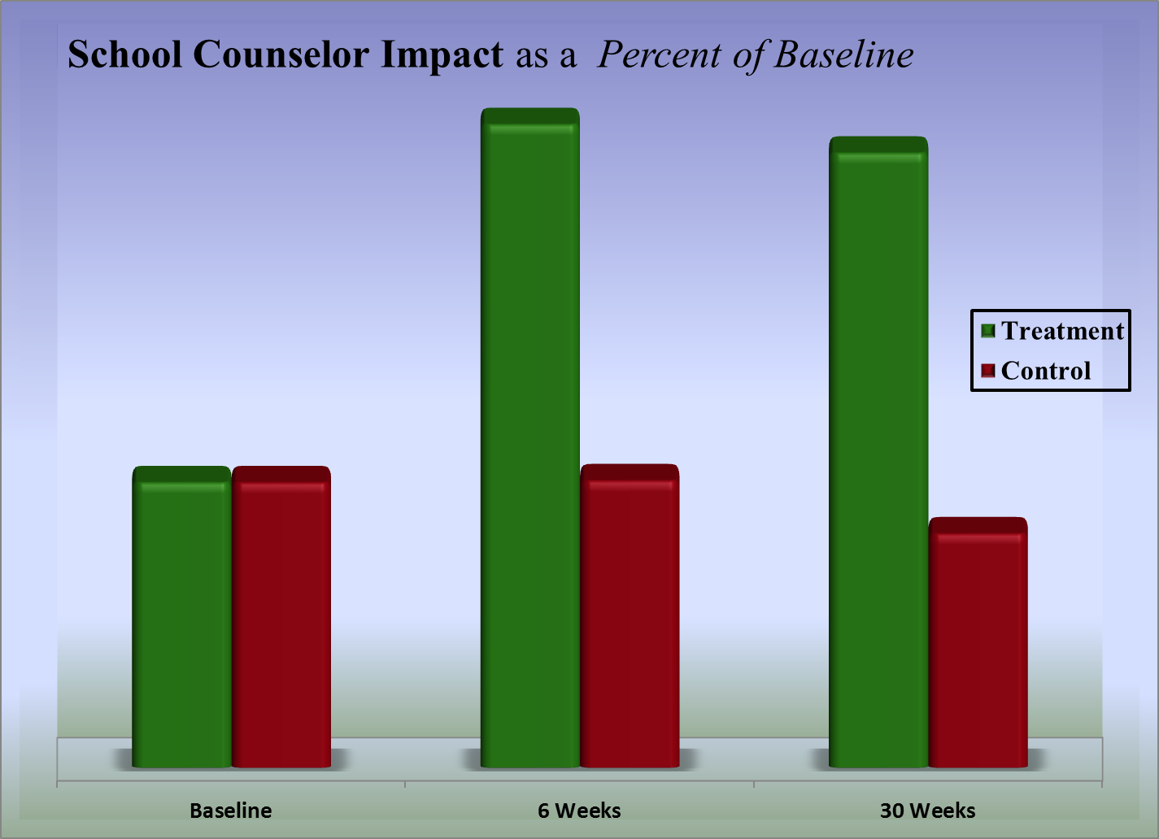
Notes:
School Counselor Impact on Classroom Climate. In terms of classroom climate, school counselors who implemented the Student Success Skills program had a significant impact on classroom learning climate both in the short term and long term.

Slide 20
SSS Meta-Analysis (2012)
Five studies:
  Brigman & Campbell (2003)
  Brigman, Webb, & Campbell (2007)
  Campbell & Brigman (2005)
  Webb, Brigman, & Campbell (2005 )
  León, Villares, Brigman, Webb, & Peluso (2010)
Notes:
This meta-analysis focused on the impact of SSS on standardized math and reading scores and involved over 12 hundred students in grades 4-9 from 39 schools

Slide 21
Sample Population
Thirty-nine schools in two large school districts located in south Florida.
Students from rural, suburban, and urban settings.
Combined total = 1,279 in grades 4, 5, 6, 8, and 9.
Ethnic composition of the total sample included:
  White = 718 (56%)
  African American = 279 (22%)
  Hispanic = 282 (22%)

Slide 22
Results of Meta-Analysis
Effect Sizes for SSS on Standardized Test Scores
ES for Math = .41
ES for Reading = .17
Overall ES =
.29
Notes:
Effect size measures the impact of an intervention. .41 is large, .17 is medium and .29 is a large effect.

Slide 23
New effect size rubric for standardized test scores
Large Effect = .25
Medium Effect = .15
Small Effect = .05 - .10
Vernez & Zimmer 2007
Notes:
Vernez and Zimmer (2007) provide guidance on interpreting the impact of reported effect sizes. They looked at the top seven standardized math and reading test given in the U.S.
And the average effect sizes found using these test with the best educational interventions to arrive at these guidelines for interpretation.

Slide 24
The Practical Impact of the SSS Program
On Math and Reading Scores
Notes:
The next slides provide a clearer picture of the impact of these effect sizes found using the SSS program

Slide 25
What can we expect from interventions aimed at improving math and reading achievement?
Hill, Bloom, Black, & Lipsey (2007)
  Reviewed dozens of meta-analyses of studies to evaluate a wide range of educational interventions and programs.
  They estimated overall effect sizes of
    0.23 for elementary,
    0.27 for middle and
    0.24 for high school students.
Notes:
Hill et all (2007) provided a helpful benchmark for accessing educational interventions. These included such interventions as new math and reading curriculums, reduced class size, comprehensive school reform among other interventions,

Slide 26
Practical significance of a
SSS .41 ES in math
Grades 4-5 An additional 4/5 of a year’s growth
Grades 6-7 An additional 1 year’s growth
Grades 9-10 An additional 1 2/3 year’s growth
Hill, C., Bloom, H., Black, A., & Lipsey, M. (2007)
Notes:
The impact on math and reading scores is quite amazing considering the amount of time involved in teaching the SSS skills to students is only 5 weekly lessons of 45 minutes and 3 booster lessons spaced one month apart. Very few educational interventions deliver as large or larger impact. Thes foundational skills are essential.

Slide 27
Practical significance of a
SSS .17 ES in Reading
Grades 4-5 An additional 1/3 of a year’s growth
Grades 6-7 An additional 1/2 year’s growth
Grades 9-10 An additional 1 year’s growth
Hill, C., Bloom, H., Black, A., & Lipsey, M. (2007)
Notes:
Even though smaller than the impact on math scores, this combination of impacting both math and reading with one limited time intervention is impressive.

Slide 28
Recent SSS Studies Show Positive Impact on:
Achievement
Pro-social skills
Bullying
Classroom climate
Self-regulation/Executive Functioning
Wellness
Self-efficacy
Notes:
Remember that in addition to impacting math and reading standardized test scores the SSS classroom program impacts all of these plus more areas

Slide 29
More Results When School Counselors
Implement SSS programs
Villares (2024) -3rd grade Attendance and emotional regulation
Mariani (2015)- 6th grade pro-social behavior and decreased bullying
Webb (2015)- 5th grade engagement, self-regulation, cooperation
Wirth (2014)-7th grade wellness
Renda (2014)- 9th grade completion rate
Weinstein (2013)- 9th grade completion rate
Jean-Jacque (2013)-5th grade Math & Reading
Urbina (2012)-9th-10th grade Math & Reading
Leon (2012)-5th grade Math and Reading

Slide 30
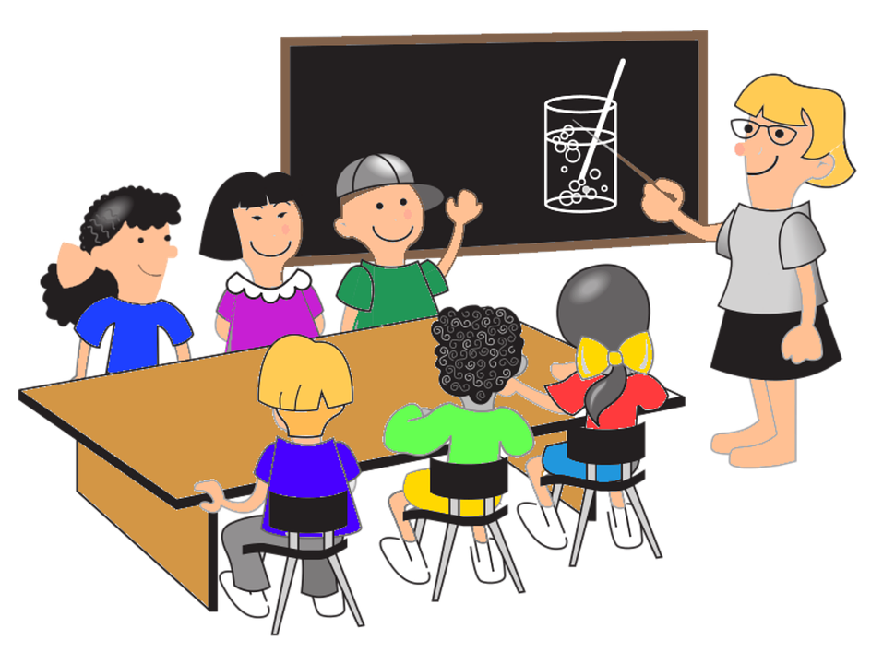
SSS and Student Behavior
Teacher Ratings
Nationally normed rating scale targeting skill areas involved in the SSS program
70% of ratings improved
Average improvement of 20 percentile points
Notes:
Teachers reported improved behavior for students participating in the SSS intervention. As students begin to acquire the skills and confidence necessary for academic success their behavior also improves.

Slide 31
SSS Support
Percent of teachers rating the seven items below on their degree of helpfulness:
Lesson addresses need 100%
Students enjoyed 98%
Students understood/applied 93%
Develops learning/social skills 93%
Involved all students 98%
Age appropriate 98%
Classroom management skills 100%
(Based on 45 teachers responding)
Notes:
Teachers who have experienced/observed the facilitation of the SSS program have shown support. A group of 45 teachers were asked to rate teach of the items on a one to five “Likert” type scale with 1 being low and 5 being high. The percentages represent teacher ratings of 4 or 5.

Slide 32

Published Research Articles
  For more details on the SSS research go to
    www.studentsuccessskills.com
  Where you can click links to the research articles and to overview descriptive articles on the SSS program.
Notes:
There is strong evidence to support the Student Success Skills program as an evidence based intervention improving the academic and social competence of students.
One of the keys to the success of the SSS program is the collaboration between the school counselor and the classroom teacher. When the teacher cues her students to use the strategies taught in the SSS program then her students are better able to master her curriculum.
The next slides provide an overview of the skills and strategies used in the SSS program.

Slide 33

Research Summary
Classroom lessons and groups focused on Student Success Skills help students to improve academic achievement and behavior
  Over 25 published studies with consistent supportive findings
  Significant gains in reading, math, and behavior
  Highly rated by teachers
Notes:
There is strong evidence to support the Student Success Skills program as an evidence-based intervention improving the academic and social competence of students.
The next slides provide an overview of the skills and strategies used in the SSS program.

Slide 34
Student Success Skills: Implementation
The SSS program is taught in five 45 minute classroom lessons spaced one week apart.
SSS is designed to be taught at the beginning of the school year.
The idea is to “set students up for success” from the start.
One key to success is for the classroom teacher to coach and cue students to use the SSS strategies to master the general curriculum throughout the year.
Notes:
One of the keys to the success of the SSS program is the collaboration between the school counselor and the classroom teacher. When the teacher cues her students to use the strategies taught in the SSS program then her students are better able to master the curriculum.

Slide 35
Student Success Skills:
Strategies and Skills
  Goal setting, progress
  Monitoring & Success Sharing
  Creating a caring, supportive and encouraging classroom
  Memory skills
  Performing under pressure
  Story structure
  Healthy Optimism
Notes:
The Student Success Skills approach is organized around five key areas. Embedded within each of these areas are specific skills and strategies students can learn to use to help them achieve academic success. The following slides highlight some of these key skills and strategies.

Slide 36
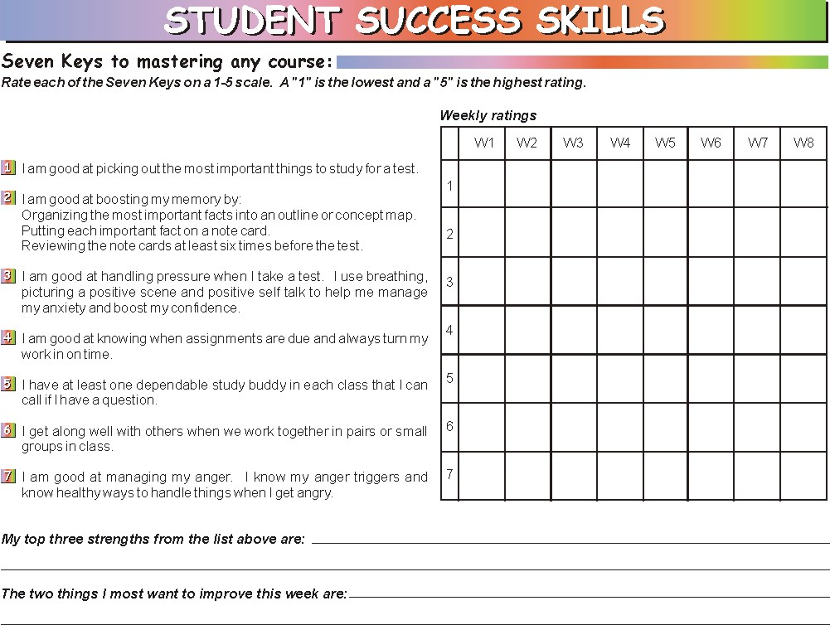
Goal setting and progress monitoring
Notes:
The research supported “Seven Keys to Mastering Any Course” are introduced. Students identify strengths and areas for improvement each week. Students learn how to set goals and develop action plans. It is most effective when teachers utilize the SSS skills and strategies as ongoing academic supports in the classroom.

Slide 37
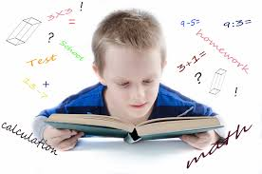
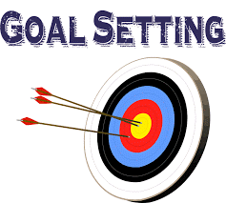

Goal Setting
(Sample Goal)
GOAL
ACTION PLAN
To improve my memory for my science test
Check with Juan to make sure I have all of the important ideas. Make an outline of the most important ideas and put them on note cards that I will review at least six times.
Notes:
Students learn to set goals and plan action based on skills learned in the SSS program. Here are a couple of examples (review slide).

Slide 38
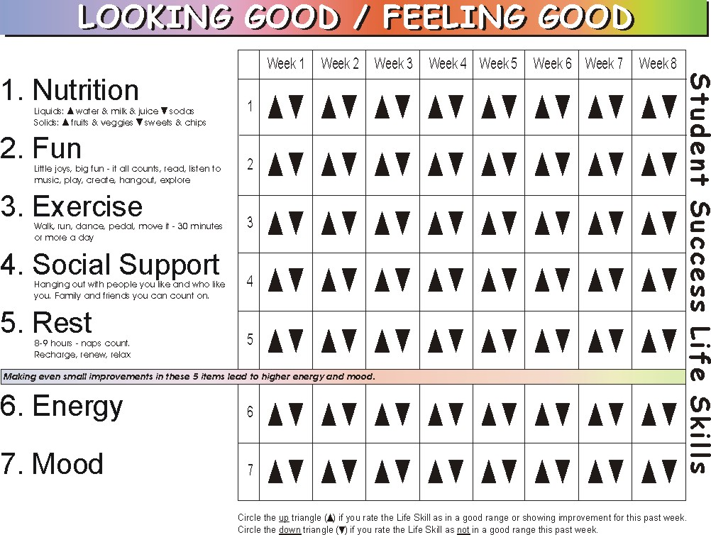
Goal setting and progress monitoring (cont.)
Notes:
Goal setting and progress monitoring are also used to monitor daily life skills. Students learn how each of the life skills relates to increased energy and positive mood and note their efforts in each of these areas weekly. Students are taught to look for patterns in their behavior and to make changes as needed.

Slide 39
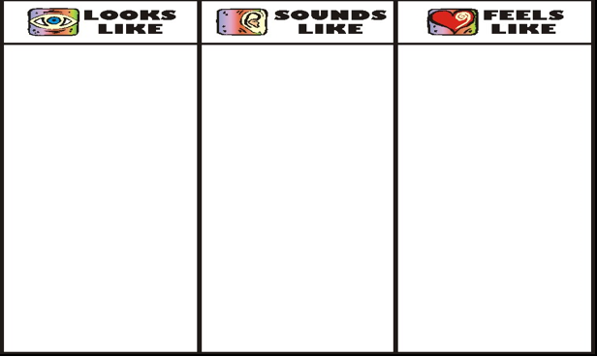
Caring & Encouraging Classroom
Notes:
Students participate in several activities geared towards enhancing support and encouragement within the classroom. In this exercise students work in small groups and share their ideas with the larger group. When used at the beginning of the year or semester it can help set the tone for academic success.

Slide 40
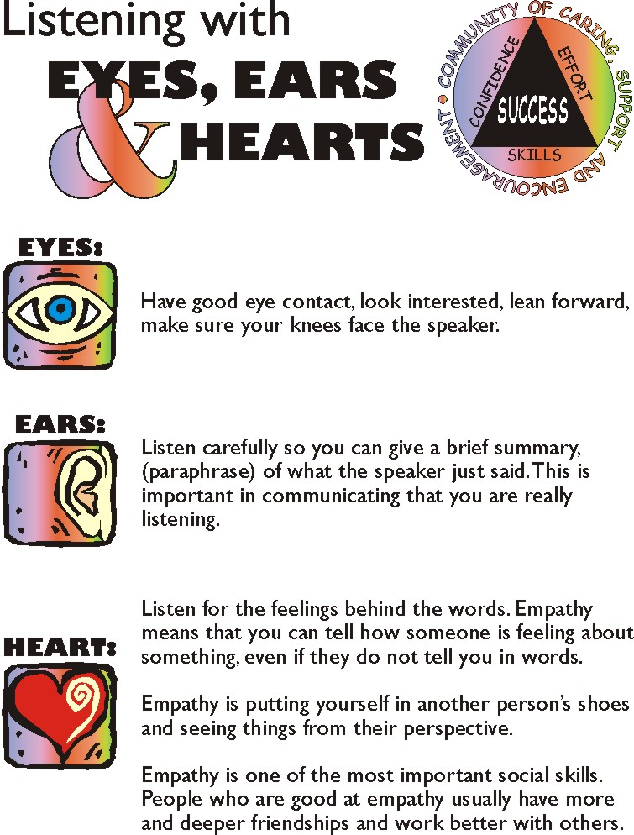
Notes:
Students learn how to listen and provide encouragement to peers. Students practice in pairs as they share improvements and recognize each other for improvements they are making.

Slide 41
Strategies for Boosting Memory
Every 20-30 minutes student share “Most important ideas”
Create/use graphic organizers-outlining—for “most important ideas”
Put “most important ideas” onto note cards and review six times
Draw a picture of the meaning of key vocabulary words
Story structure
Location Memory
Notes:
Let’s look at a few other strategies.
NOTE: It is very helpful to talk with the teacher and enlist their support in reinforcing these memory strategies. Having some examples from the teacher of graphic organizers and getting the teacher to provide time in class to have students work together to create their own graphic organizers and compare “Most important ideas” and then make note cards from the graphic organizer before the next test is the best way to show students how powerful these techniques are. Inspiration Software is one of the leaders in visual learning. You can download free examples at www.inspiration.com. Many recent texts have graphic organizers for each chapter.

Slide 42
Performing Under Pressure
Managing Anxiety
Calm Place
Breath, Picture, Focus
Positive Self Talk*
Keep Kool Tunes
Notes:
Students participate in an activity using their imagination to create a “Calm Place” to go to when under pressure. Students practice slow breathing while picturing themselves in their Calm Place. As anxiety is reduced, students can begin to focus on the task at hand. Students learn and practice positive self talk statements *(next slide) to increase self-confidence in being able to accomplish the task. Keep Kool Tunes are another fun and motivating way for students to surround themselves with positive messages. Teachers can cue students to use these strategies as they prepare for testing.

Slide 43
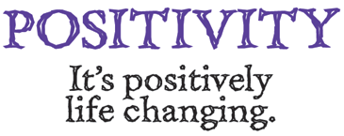
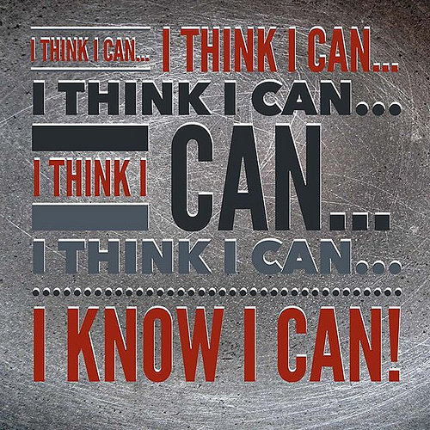
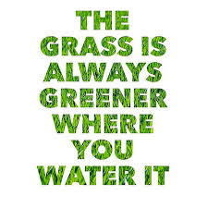
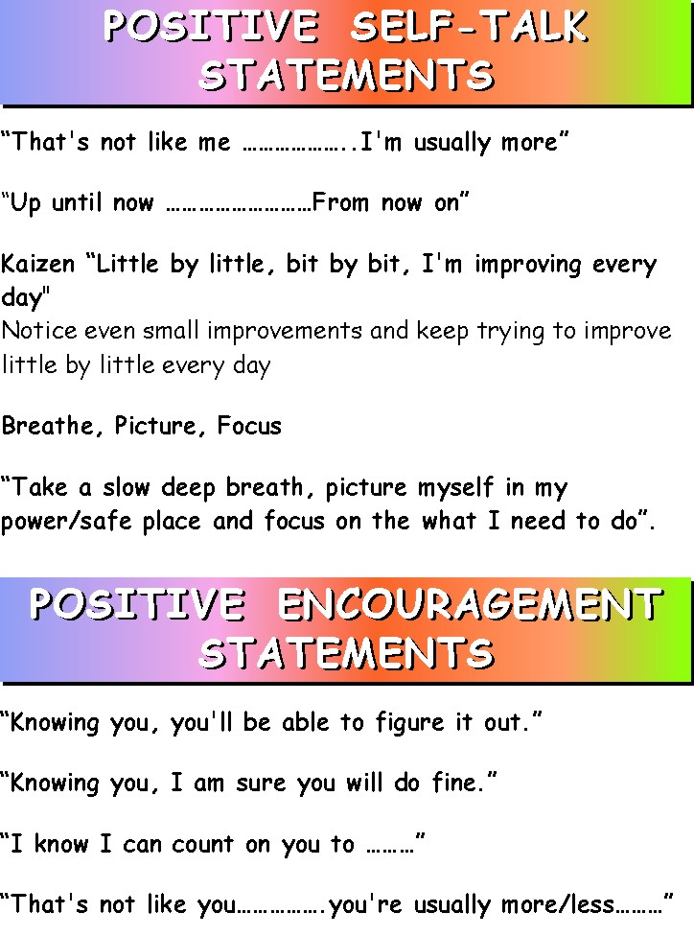
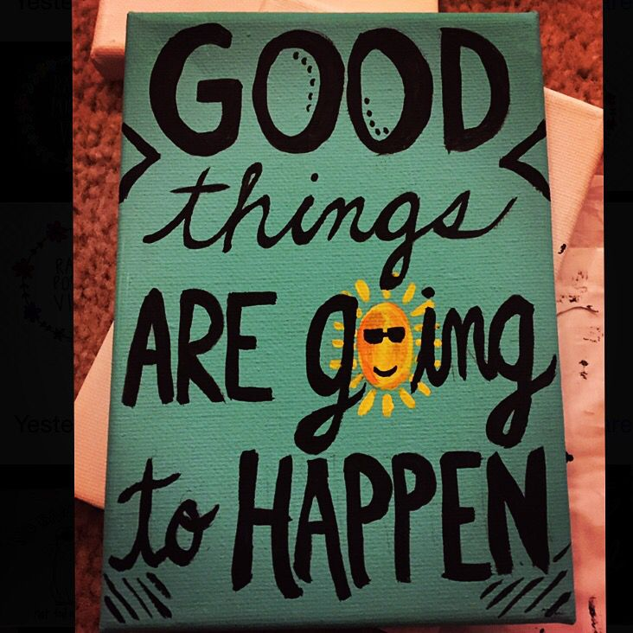
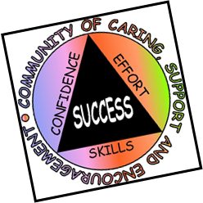
Notes:
Positive self talk and encouraging statements help keep students on track when faced with anxiety and pressure. Some degree of anxiety and pressure are to be expected as students are asked to perform, however, when it becomes overwhelming students need strategies to regain control and focus. Teachers can notice student efforts to be positive and encouraging and cue them when necessary.

Slide 44
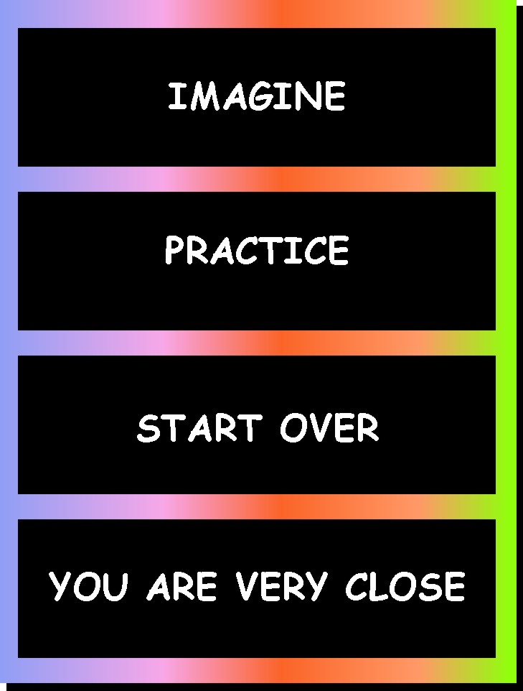
Performing Under Pressure (cont.)
Mental Practice and Putting Your Plan into Action
Notes:
Students can combine several strategies for managing pressure starting with being able to imagine themselves being successful. Students are guided through an activity called “the power of mental practice” followed by practice and progress monitoring. Increased practice results in improved skills. If goals are not met, students can identify additional strategies and start over. Students use positive self-talk and encouragement to notice even small improvements increasing motivation to continue trying.

Slide 45


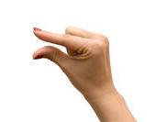
Kaizen
“Little by little, Bit by bit, I’m improving, Everyday!”
Continuous improvement
The ability to notice even very small improvements in ourselves and also in others
Notes:
The Japanese concept of “Kaizen” is a key to the Student Success Skills approach as they set goals, develop plans, and monitor progress towards improved academic and social competence

Slide 46

Story Structure and Personal Story Telling
Describing main Characters in the story:
(appearance, character, mood)
Describe the Setting of the story:
When did the story take place?
Where did the story take place?
What did the setting look and feel like?
Describe the main Problem facing the central character in the story:
Describe how the main problem was solved:
Describe the Feelings of the characters at various points in the story:
Beginning:
Middle:
End:
Describe the Main Idea/Themes of the story:
Notes:
The final strategy and area of skill development involves story structure and positive student story telling. Story structure provides students a strategy to make understanding and remembering stories easier and helps them become better writers. Students learn to identify key concepts and to create their own stories based on story starters such as “A time I started a healthy habit, A time I helped someone with a problem, or A time I made a new friend.” As with all skills and strategies introduced to students through the SSS program, teacher collaboration and incorporation of ideas into daily curriculum enhances learning outcomes.

Slide 47


Healthy Optimism
Students are taught not to doubt their ability
They can doubt their strategy if it is not working
They are taught to “Try something Different” if what they are doing is not working.
Notes:
Have students join you in the Optimism Cheer: Prompt students with these three lines and ask for a choral response: Students repeat the key word or phrase that is underlined and in blue.
Don’t doubt your ability.
You can doubt your strategy.
If what you are doing is not working try something different

Slide 48
Healthy Optimism
The SSS program builds Healthy Optimism by teaching students to:
  set goals, develop plans, and monitor progress and try new strategies when their plan is not working.

Slide 49
Session Formats
Beginning
Review of previous session
Looking Good/Feeling Good: goal reporting, progress monitoring, success sharing and goal setting
Middle
New skills/strategies are introduced, modeled, and practiced
End
Session review
Seven Keys to Mastering any Course: goal reporting, progress monitoring, success sharing and goal setting
Notes:
The SSS Classroom lessons follow a this format. Embedded within each session are opportunities to evaluate progress and set goals. Students are also encouraged throughout all sessions to use the listening, encouragement, and coaching skills they are learning and to notice even small improvements in themselves and peers.

Slide 50
SSS is your Go To program for
ASCA Mindsets
SSS includes a tier one universal classroom based program
SSS includes a tier two small group counseling program
SSS is uniquely tied to the ASCA National Model of modern school counseling

Slide 51
SSS and ASCA Mindsets

Slide 52
SSS and ASCA Learning Strategies

Slide 53
SSS and ASCA Self-Management Skills

Slide 54
SSS and ASCA Social Skills

Slide 55
For more information contact:
Dr. Greg Brigman
Florida Atlantic University
gbrigman@fau.edu
Notes:
School counselors are part of the educational community focusing on academic achievement by helping students develop the academic, social, and self management skills they need to succeed. School counselors can support teachers in their instructional efforts to help students achieve academic outcomes in line with their potential.

